Slide 1

Video #4
HARDWARE - 3
BEGINNER TO EXPERT GUARANTEED
ULTIMATE IT COURSE
ACCESS NETWORKING COURSE PLAYLIST LINK IN DESCRIPTION
SUBSCRIBE!!!

Slide 2
Answers:-
1. UPS inputs Alternate AC Current ? (AC/DC)
2. Mechanical Keyboard is ideal for story writers ? (Multimedia/Mechanical/Gaming)
3. Abbrevation of PS2 is Personal System? (Play Station/Personal System)
4. List five popular brands of Printer? (Canon/HP/Epson/Brother/Genric)
5. Pink Audio port is for Microphone ? (Speakers/Headphone/Microphone)

Slide 3
Components?
Components are those Hardware items which are Hard, Visible & Touchable. The Hard Components of a computer system are placed under a Cabinet. The Components which are usually popular is like – Hard disk Drive, Microprocessor and RAM etc.

Slide 4
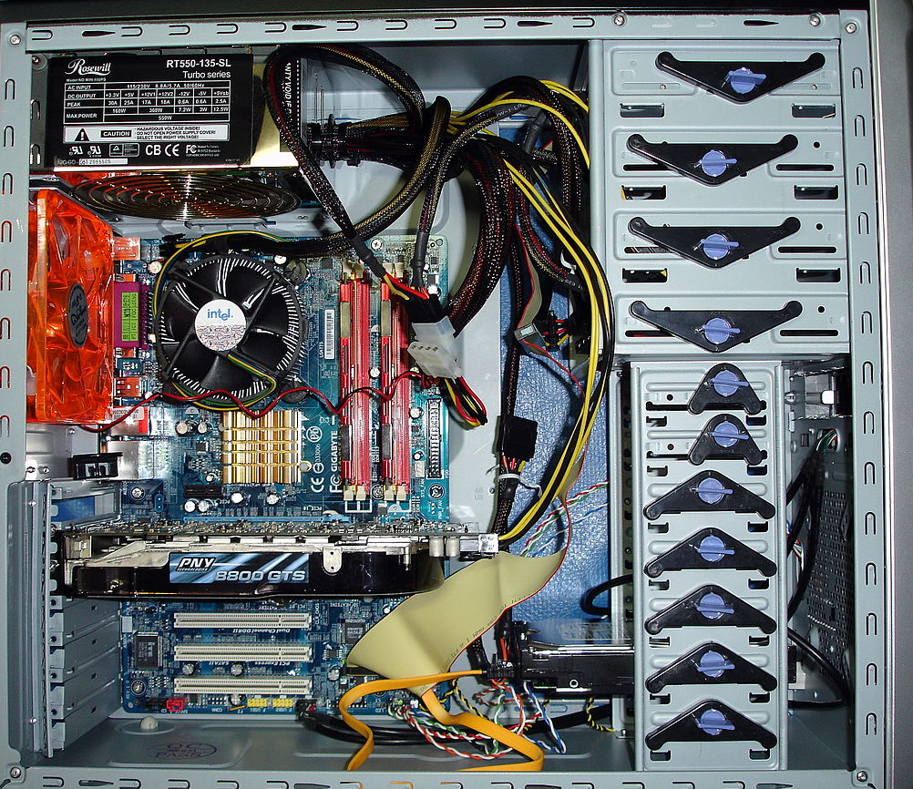

Slide 5
PCB
MOTHERBOARD OR PRINTED CIRCUIT BOARD

Slide 6
WHAT IS
It is known as the Interconnection of Components in a computer
MOTHERBOARD
It is a Circuit board which have ports and sockets with transistors coating to connect components together
It is responsible for contact of flow of data and instruction with the help of BUSES
Two types of Motherboard 1. Plane 2. Mark

Slide 7
MAJOR BRANDS
DESKTOP
MBOARD
LAPTOP
MBOARD
SERVER
MBOARD
1.
2.
3.
It is used in Desktop Systems. It comes with Upgradation Capability. We can Upgrade it Easily
It is used in Laptop. All components are placed in limited space. Rare mboard allows Upgradation
It is used in Server. Bigger in size having many ports and designed for high end works

Slide 8
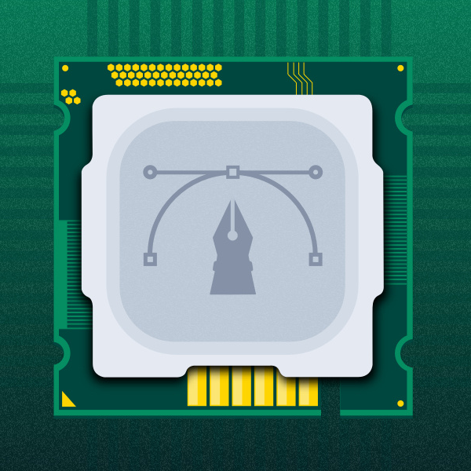
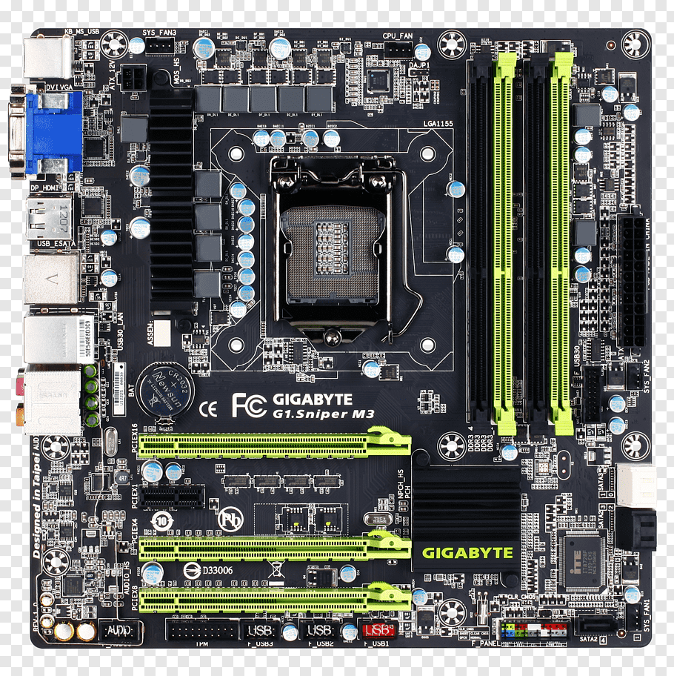
TYPES OF PCB
Mini ATX
Flex ATX
Micro ATX
EATX
Pico ATX
ITX
NLX
BTX
Mobile ATX
WATX

Slide 9
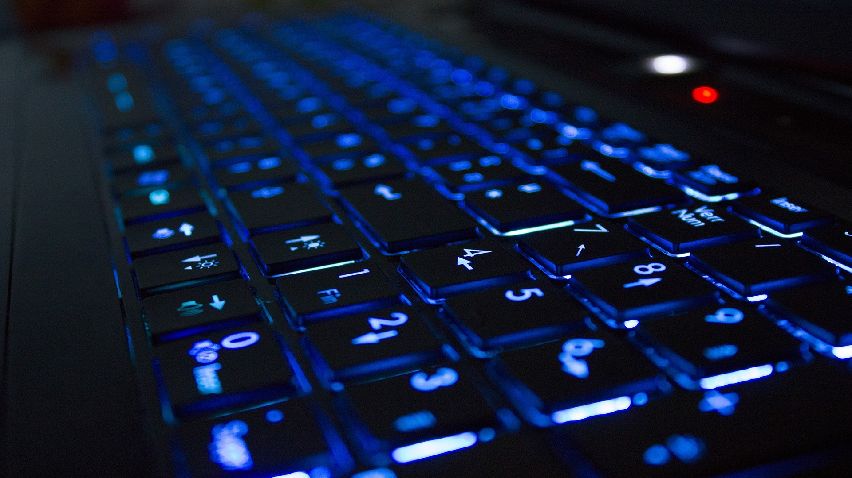
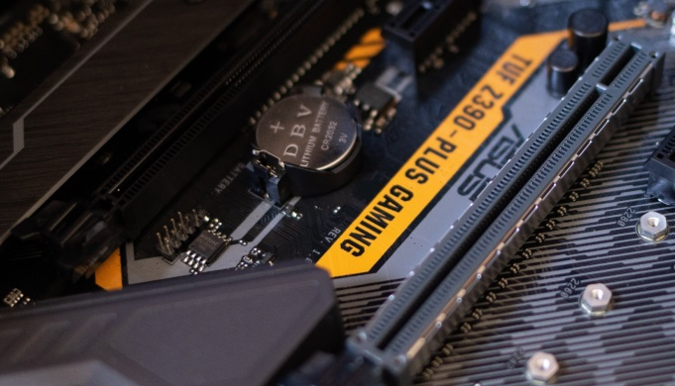
BUSES in Motherboard
DATA BUS :- It Sends and Receives data to Memory.
ADDRESS BUS :- It Sends Address of Inputs to the Memory or RAM
CONTROL BUS :- It Makes the Communication between CPU and Components

Slide 10
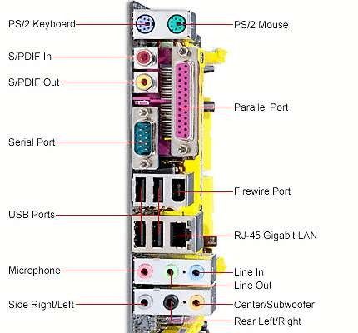
BACK PANEL CONNECTORS AND PORTS

Slide 11
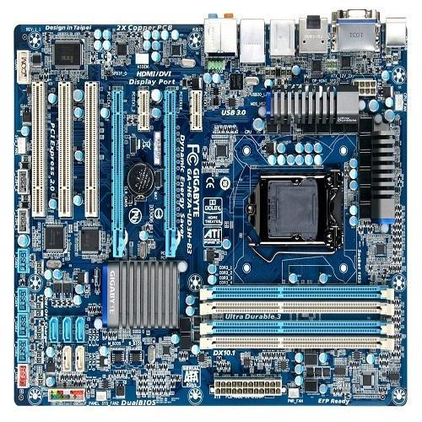
CPU Socket
RAM Slots
PCI Slots
CMOS
ATX Power
SATA Slots
AGP Slots
Chipset
North Bridge
South Bridge
Sandy Bridge

Slide 12
CPU
Control Processing Unit

Slide 13
WHAT IS
It is known as the brain of the Computer. It is first priority to run Machine
MICROPROCESSOR
It is a chip based structure made up of millions of transistors and logic gates
It receives the incoming instructions as input from Memory or RAM, Procced it and gives result as Output
It is Responsible for the Speed and Capacity to execute tasks in computer systems
These Microprocessor are Categorized into 2 different architecture 32 BIT and 64 BIT

Slide 14
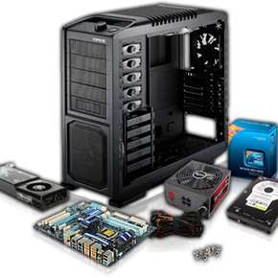
SEGMENTS OF CPU
CATEGROIZED INTO 2 DIFFERENT SEGMENTS
ARITHMETIC LOGICAL UNIT
CONTROL UNIT
Known as ALU
Known as CU
It performs all the Arithmetic, mathematical, algebraical and logical tasks like Addition, Divide, Multiplication, Subtraction and Modulus. It also performs Logic tasks like OR, AND and NOT
It is responsible for controlling the flow of data between Microprocessor and the external components of the computer using the CPU Buses.
THESE ARE THE FACTORS WHICH MAKES A PROCESSOR TO PERFORM TASKS FREQUENTLY!

Slide 15

BUSES in MICROPROCESSOR
CPU consists 3 Buses mention below. Basically Buses are used as medium or carrier of information or data between the microprocessor and the memory and components of the system. It carries the instruction from memory to CPU & back CPU to memory after processing….
DATA BUS :- It Sends and Receives data to Memory.
ADDRESS BUS :- It Sends Address of Inputs to the Memory or RAM
CONTROL BUS :- It Makes the Communication between CPU and Components

Slide 16
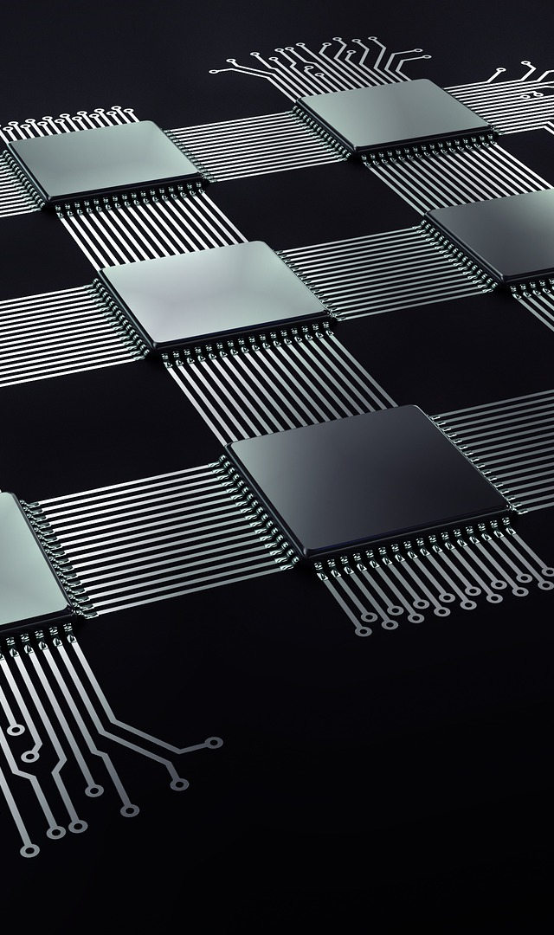
MAJOR SPECIFICATION OF MICROPROCESSOR
Clock Speed :- Clock Speed is a unit to measures the number of instructions executes by the working microprocessor within a second is called Clock speed. It is measured in GHz.
Specifications of CPU
Cache Memory :- It is Static natured and Quick responsive memory, by structural it is made up of 6 Transistors and 1 Capacitors in each cell block. cache Memory are categorized into 3 types L!, L2 and L3
Operating Voltage :- It means how much Power or Voltage a microprocessor needs to performs tasks.
FSB :- It stands for Front Side Bus. It is a data bus which carries the data from RAM to Processor and then back processor to RAM as a procced instruction.
All the Information mentioned upon the Processor

Slide 17
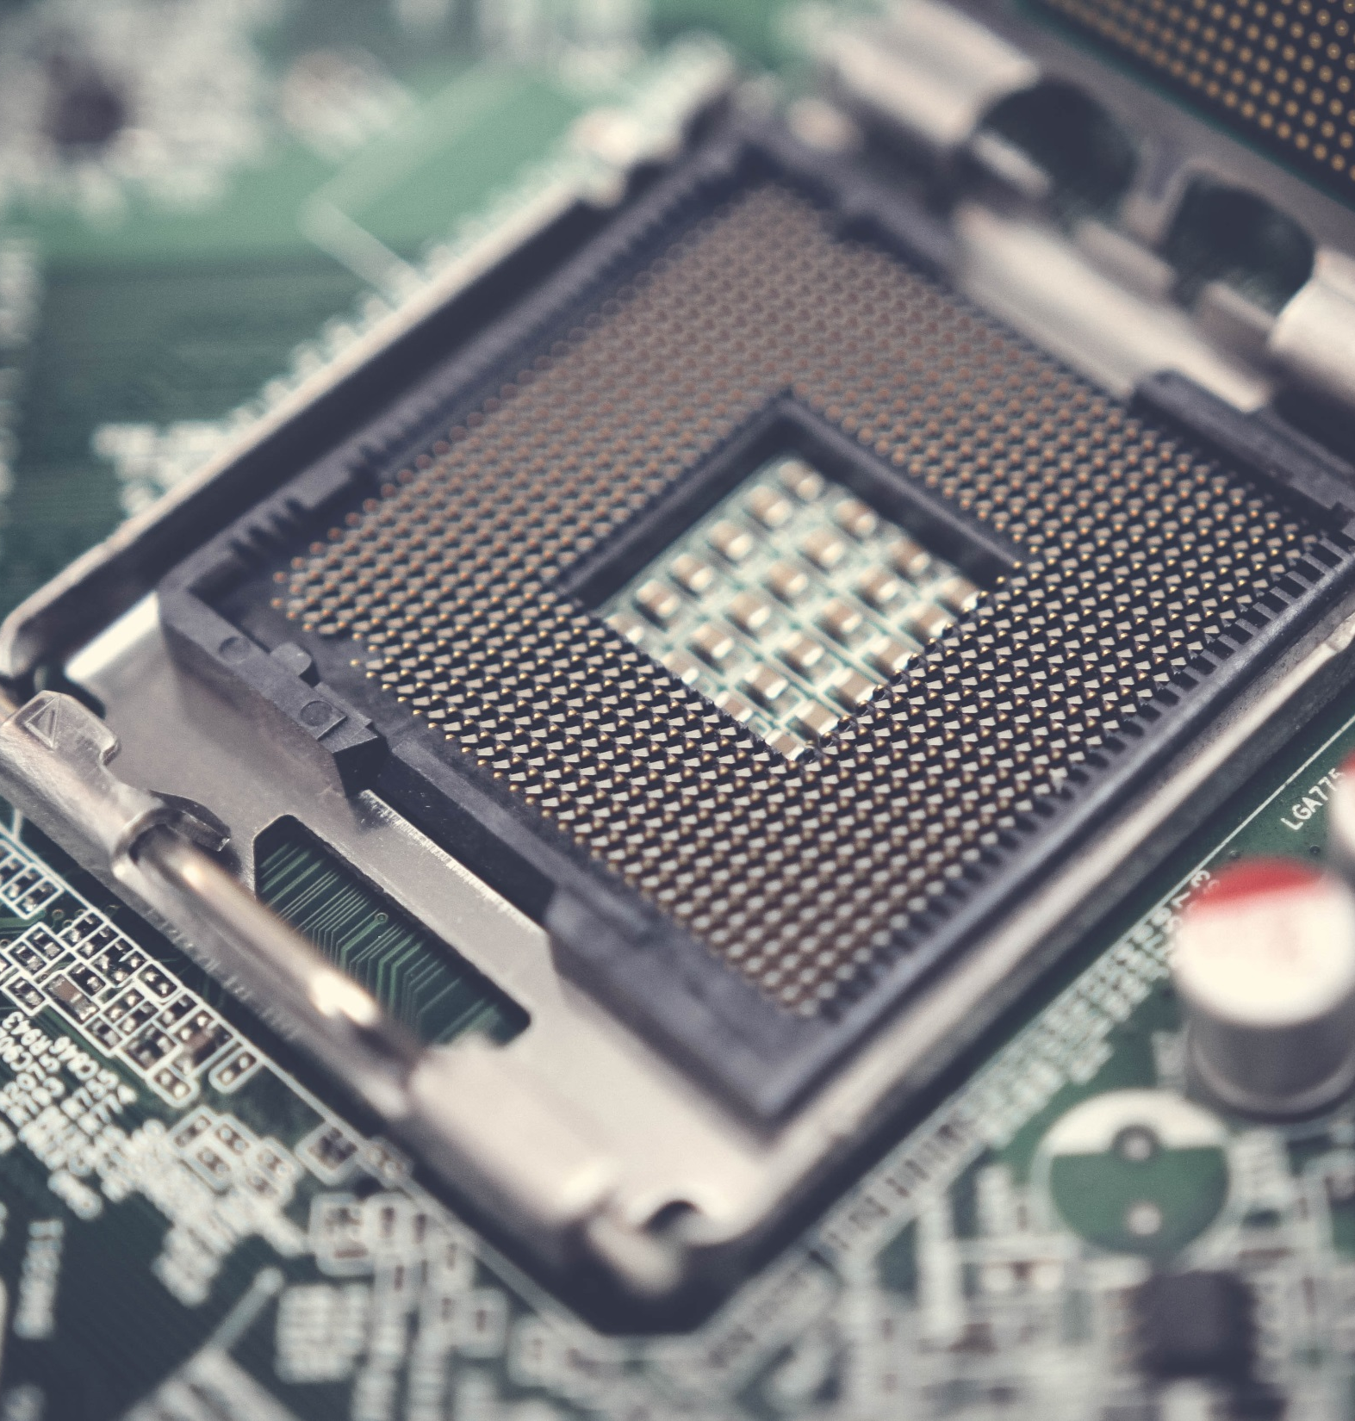
PACKAGING???
The process of installing the microprocessor in motherboard is known as packaging. In Motherboard there are different different types of packaging for different different types of micro processor……
Packaging is based upon which micro processor you want to install in your system. The processor is install and fix with the Socket in Motherboard….
CPU Installation

Slide 18
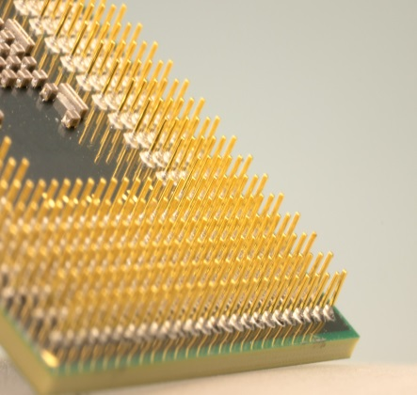
SOCKETS FOR CPU
According to Structure Sockets are a collection or a Array of Pins which holds Microprocessor.
Sockets are used to adjust the position of Microprocessor in the Motherboard. These are Categorized according to the Brands and Version of Microprocessors…
For Latest Intel 10th Generation Core i9 Processor Supports LGA 2066 Socket.
INTEL | No. of pins | Processor
LGA | 1151 to 1155 | I3, i5 & i7
PGA | 478 | Pentium I
PPGA | 775 | Pentium II
FC-PGA | 479 | Pentium III
AMD | No. of pins | Processor
C Series | Socket C32 | Opteron
AM Series | AM 1 to 4 | Ryzen 3, 5, 7, Phenom, Athlon & Sempron
A Series | Socket A462 | Duron & Athlon
FM Series | FM 1 to 2 | Trinity & Llano

Slide 19
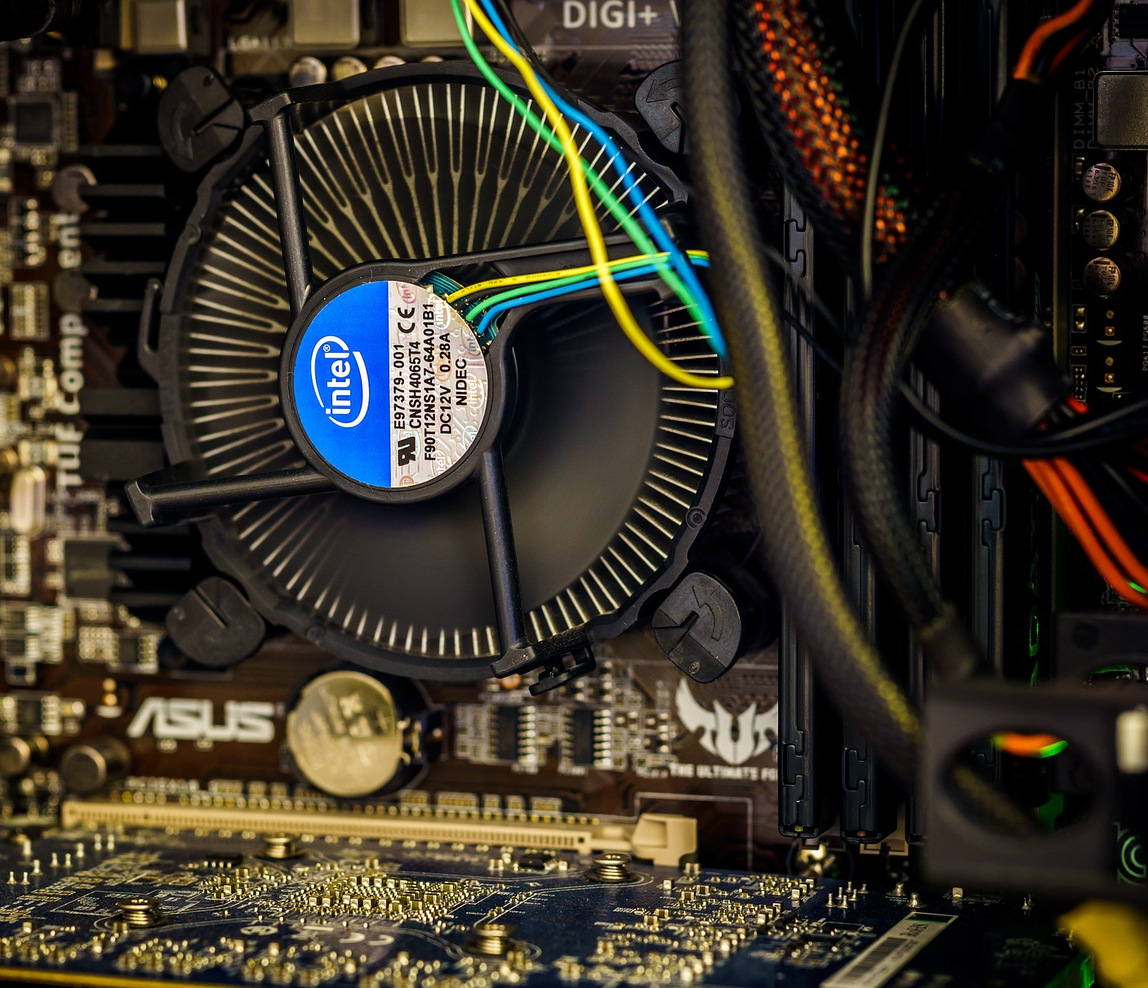
HEAT SINK
SOLUTION FOR
OVERHEATING
When we use system it release a lots of heat. To prevent and Release heat we install Heatsink in our Motherboard.
Types of Heatsinks :-
Active Heatsink :- Heatsink which have Fan Installed is known as Active Heatsink
Passive Heatsink :- Heatsink which have Fan Installed is known as Passive Heatsink
Heatsink is attached with Microprocessor with the contact of Thermal Paste or Grease Which extremely absorb heat from microprocessor.

Slide 20
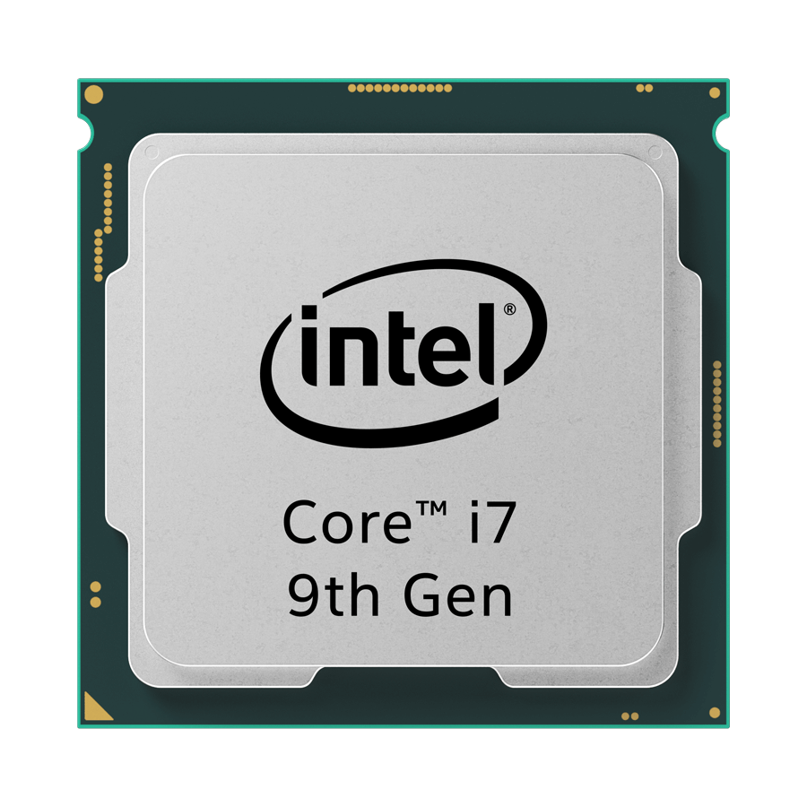
Generation
Core
Threads
Frequency
L1, L2 & L3 Cache
Hyper threading
Overclocking
Turbo Boost
Integrated GPU
Transistor Size
Bottleneck

Slide 21
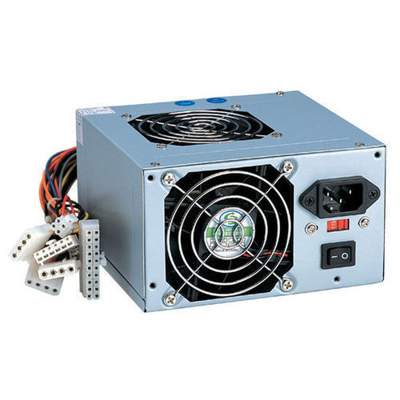
SMPS – Switched Mode Power Supply

Slide 22
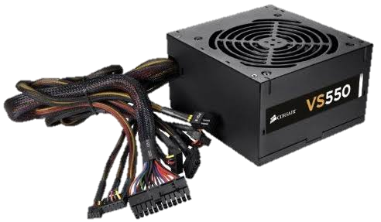
WHAT IS SWITCHED MODE POWER SUPPLY (SMPS)?
A SMPS IS A DEVICE USED TO INPUT POWER TO ALL COMPONENTS OF MOTHERBOARD IT CONTAINS DIFFERENT COLORS WIRES HAVING DIFFERENT VOLTAGE FOR DIFFERENT COMPONENTS IN CPU CABINET

Slide 23
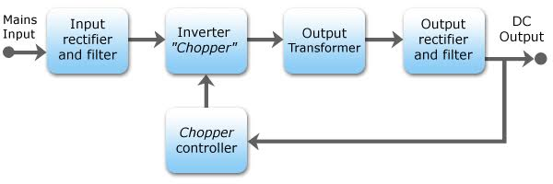
HOW SMPS WORKS

Slide 24
Rectifier & Filter - It is responsible to converting AC to DC Current and Filter Filterize the Impurities in Current
Inverter - It emphasize the wire bunch of diffent components
Transformer - It Transfer the Power to different different Components
Rectifer - It pass the balanced current to the components

Slide 25
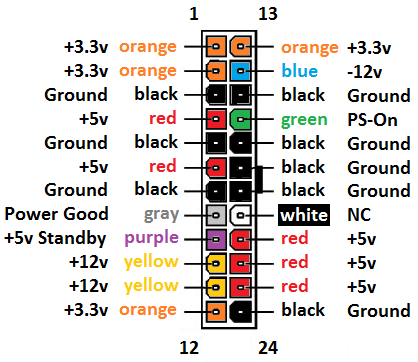
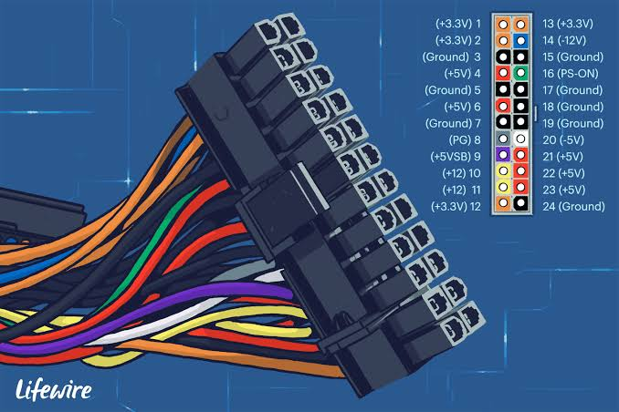

Slide 26
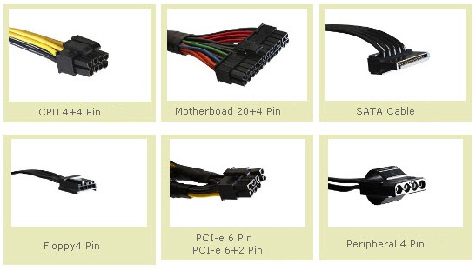
Connectors
4 PIN PCB Power
20/24 PIN ATX
15 PIN SATA Power
6 PIN Floppy Power
6/8 PIN PCI Power
4 PIN MOLEX

Slide 27
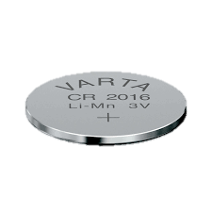
Cmos battery
CMOS Battery is used to update Date & Time while the system is off
Stands for Complementary Metal Oxide Semi Conductor
Having Connection with RTC and Jumper Settings to RESET BIOS

Slide 28
Questions:-
1. Whats is AMD ryzen 5 ? (RAM/Processor/Motherboard)
2. Identify the generation of Processor Intel i7 9440 ? (5th/8th/10th/9th)
3. Voltage of Yellow wire in SMPS ?
4. How we pervent heat generated by working Microprocessor ?
5. Work of North Bridge & South Bridge in Motherboard ?
Solve all question and comment down answers...

